Slide 1
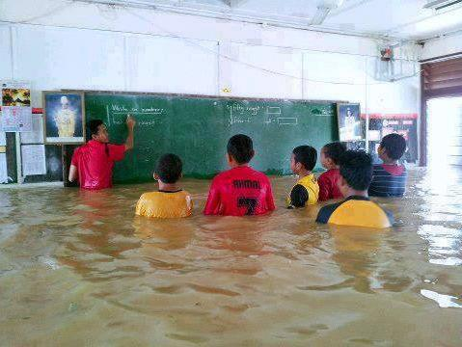
What technical issues have you needed to deal with today?

